Slide 1

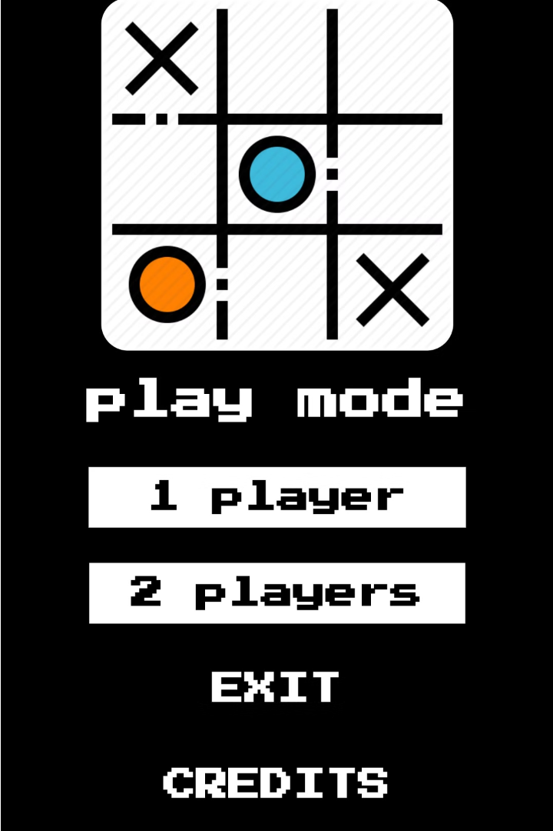

Introduction to Tic Tac Toe Game in Python
Dive into the world of creating a classic Tic Tac Toe game using Python and the Pygame library. Explore the power of object-oriented programming as we build this timeless game from the ground up.
by Samarpan Piya

Slide 2
Pygame Library: Why and How
Why Pygame?
Key Features
Pygame is a popular Python library for creating 2D games and multimedia applications. It provides a set of tools and functions that simplify the process of game development, making it an excellent choice for beginners and experienced developers alike.
Pygame offers a wide range of features, including efficient event handling, smooth animation, sound support, and easy integration with other Python libraries. It allows developers to focus on game logic and design, rather than low-level details.

Slide 3
Object-Oriented Programming Approach
1
Class Design
2
Encapsulation
The game was built using an object-oriented approach, with 8 distinct classes representing different aspects of the Tic Tac Toe game, such as the game board, players, and game logic.
Each class encapsulates its own data and behavior, promoting modularity and making the code more maintainable and scalable.
3
Inheritance and Polymorphism
4
Abstraction and Interfaces
The game leverages inheritance and polymorphism to create a cohesive and flexible game structure, allowing for easy extensions and modifications in the future.
Key game components are abstracted behind well-defined interfaces, enabling the use of a consistent API and promoting loose coupling between different parts of the application.

Slide 4
8 Classes Used in the Game
These 8 classes are responsible for the game board, game logic, and different aspects of players, such as being human or computer-controlled. The classes are designed to work together to create a seamless gameplay experience.
Game
Manages the overall game flow, including levels, players, and game state transitions.
Level
Represents a game level with varying difficulty.
Board
Represents the game board and provides methods to manipulate and check the board state.
Player
Base class for players (both human and AI).
HumanPlayer (inherits from Player)
Represents a human player.
AIPlayer (inherits from Player)
Represents an AI player with different difficulty settings.
GameInterface
Manages the graphical user interface for the game using Tkinter.
GameLogic
Contains the logic to check for a winner in the game.

Slide 5
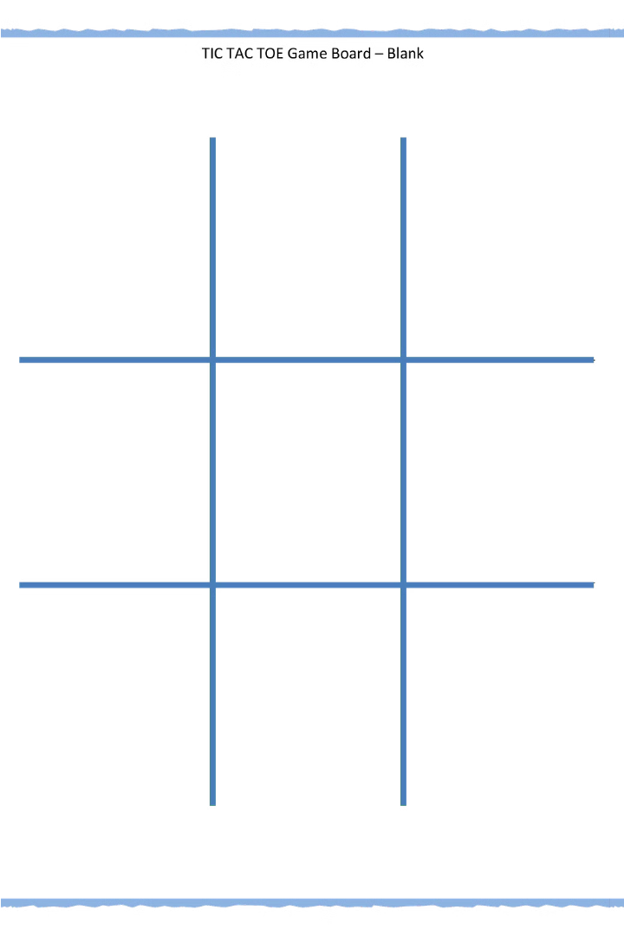
Game Board and Grid Representation
The tic tac toe game board is represented as a 3x3 grid, with each cell containing either an X, an O, or being empty. The grid is implemented using a 2D list, where each inner list represents a row of the game board.
Players take turns placing their respective symbols (X or O) on the grid, trying to achieve a winning combination of three in a row, column, or diagonal.

Slide 6
Player and Computer Moves
Player's Turn
1
The player selects an available square on the game board to place their mark (usually an 'X').
Computer's Algorithm
2
The computer analyzes the current board state and employs a strategic algorithm to determine the best available move.
Placing the Mark
3
The computer then places its mark (usually an 'O') on the selected square, updating the game board.
The player and computer take turns placing their respective marks on the game board, with the goal of achieving a winning pattern of three marks in a row (horizontally, vertically, or diagonally). The game continues until either a player wins or the board is filled, resulting in a tie.

Slide 7
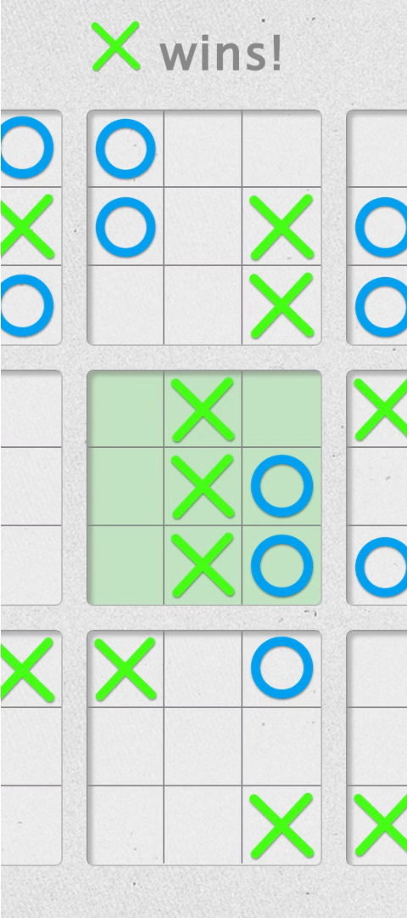
Winning Condition and Game Logic
Determining the Winner
Blocking the Opponent
The game logic checks for a winning condition by examining the state of the game board. It looks for a row, column, or diagonal with three matching X or O symbols.
The computer player employs strategic thinking to block the human player's potential winning moves, making it harder for them to claim victory.
Handling Tie Games
If neither player can achieve three in a row, the game ends in a tie, and the result is displayed to the players.

Slide 8
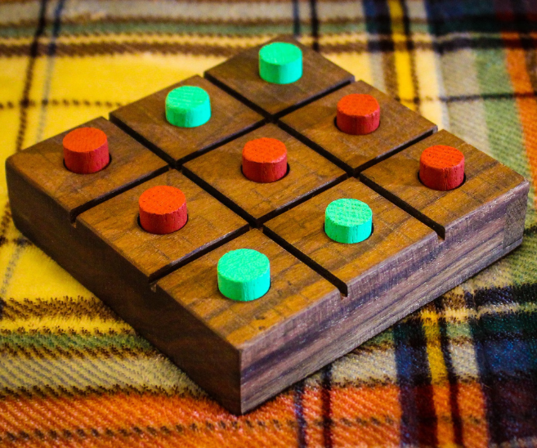
Graphical User Interface (GUI) Design
The graphical user interface (GUI) of the tic tac toe game was designed to be clean, intuitive, and visually appealing. The game board was rendered as a 3x3 grid of responsive squares, allowing for easy tracking of the player's and computer's moves.
Vibrant X and O icons were used to represent the players, creating a classic tic tac toe feel. The background and color scheme were chosen to provide a calm and relaxing gaming experience, encouraging focused gameplay.

Slide 9



Handling User Inputs and Events
User Inputs
Event Handling
Mouse Interactions
The game captures user inputs through the keyboard or mouse. Players can make moves by clicking on the desired grid cells.
Pygame's event handling system is used to detect and respond to user actions, such as click events, key presses, and window resizing.
The game utilizes mouse events to allow players to select grid cells and make their moves. The cursor position is mapped to the game board.

Slide 10

Conclusion and Future Enhancements
In summary, we have developed a robust tic tac toe game using Python and the Pygame library. By leveraging object-oriented programming principles, we have created a scalable and maintainable codebase. Looking ahead, there are several exciting opportunities to enhance the game further.

